Slide 1
From the Page to the Stage
Thinking like a director

Slide 2
Getting a concept
  Type of theatre
  Costuming
  Movement
  Characterization
  Metaphor
  Sets

Slide 3
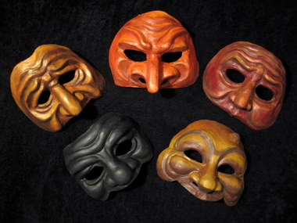
Getting a Concept

Slide 4
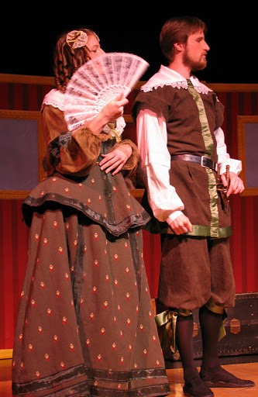
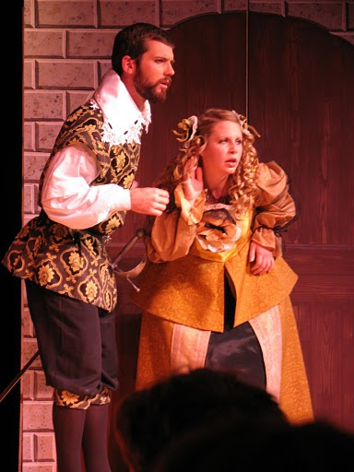
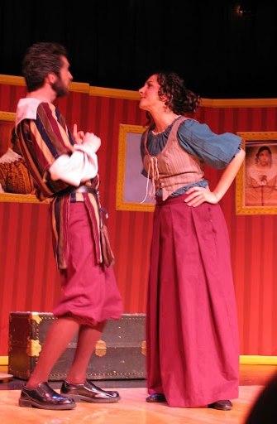
Getting a Concept

Slide 5
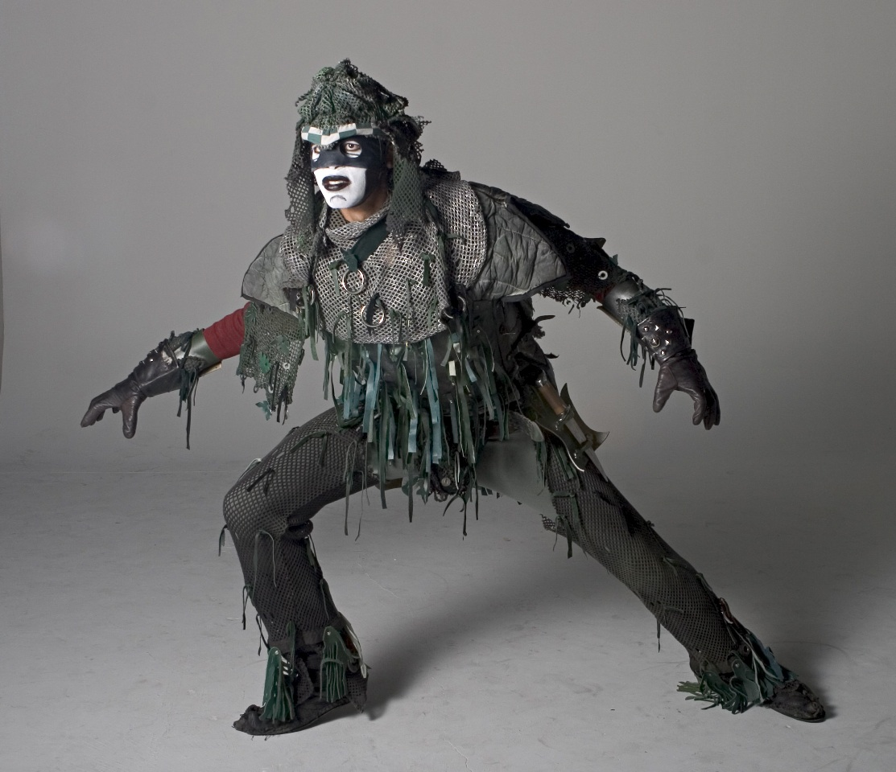
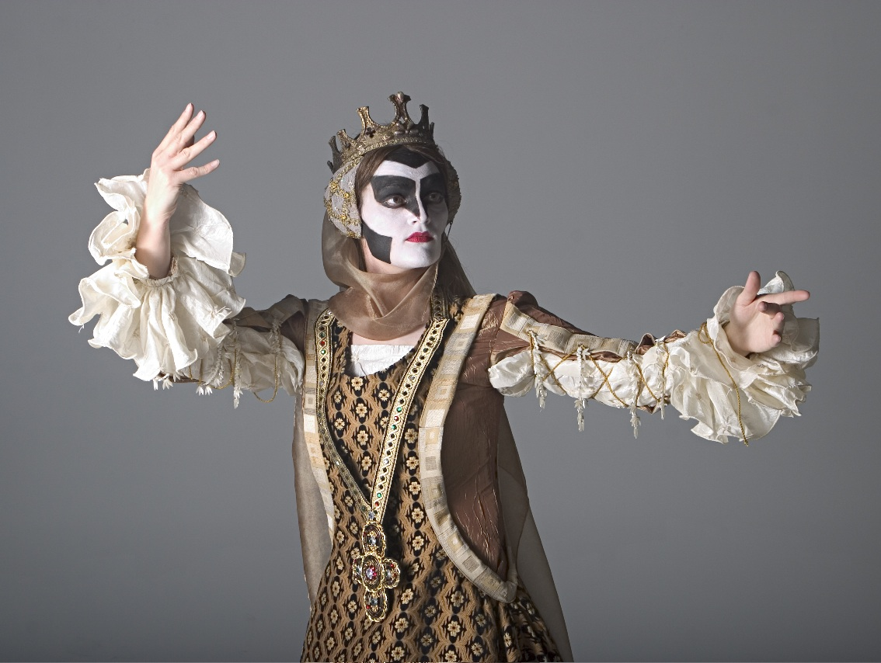
Getting a Concept

Slide 6
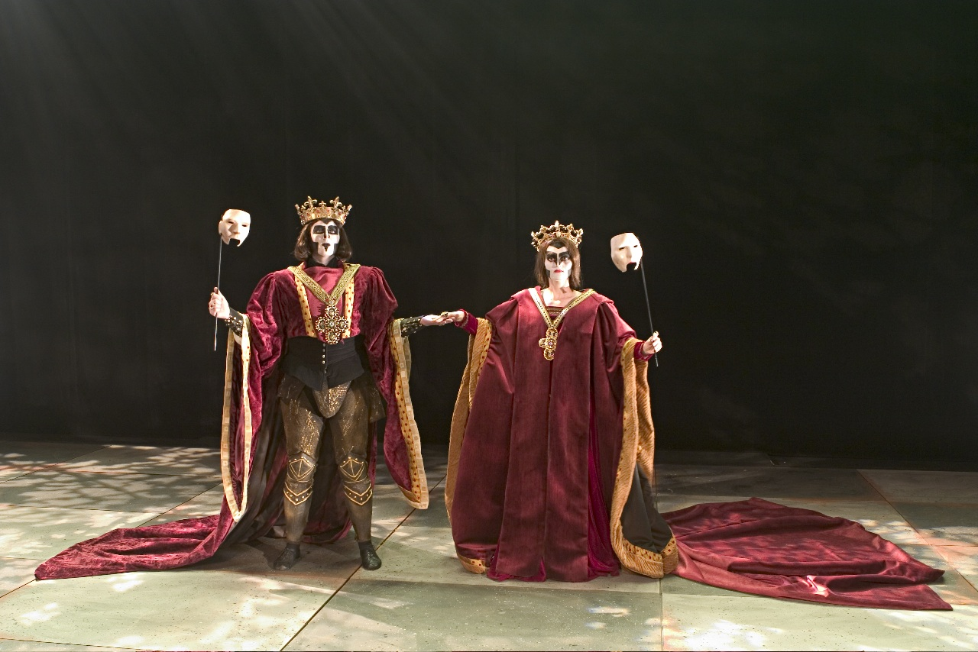
Getting a Concept

Slide 7
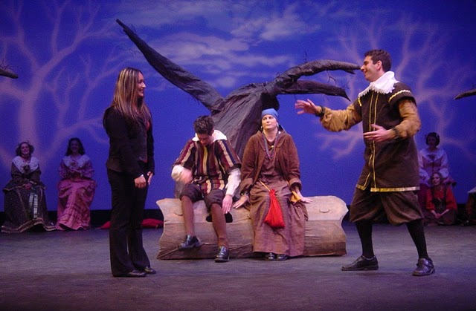
Getting a Concept

Slide 8
Observe & Replicate Human Behavior
Behavior in comedy is often an exaggerated manifestation of actual human behavior
Push the actors as far as you can until bordering on the ridiculous (and reign then in if they go too far)
Ask the actors to come up with acting ‘choices’ you can pick from
Blocking (placement and movement on stage) is essential

Slide 9
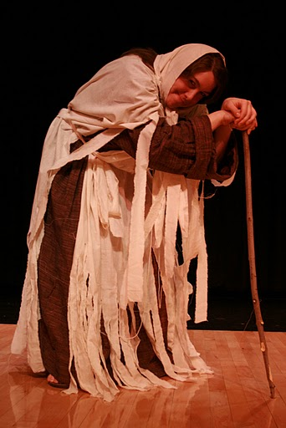
Observe & Replicate Human Behavior
Groucho Marx’ duck walk was an exaggeration of an affected walk popular in the late 1800s.
Exaggerated physicality based on reality

Slide 10
Humor
Find the funny in the script
  Puns and word plays
  Phrases modern audiences can connect with
  Situational humor
Timing/Presentation
  Don’t step on each other’s lines, don’t upstage anyone
  Allow for pauses, but keep a quick pace
  Characters can laugh at their own jokes
Asides
Add-ins/Ad-libs
  Ask the actors to try things out – if they don’t work, don’t use them again, but if they do, build on them
  Asides allow the audience to be in on the joke & participate

Slide 11
It’s your turn
What concept could work here?
Find the funny
  Puns, word play, situation, etc.
What are the characters like?
  Personality, physicality, etc.
Where are they & where do they stand onstage?
How are the asides delivered?

